Slide 1
Ace Training Network Solution
The Engineers
Callum Owen-Bridge
Keiran Brown
Karl Myers
Andrew Campbell
Karl McCallion

Slide 2
Introduction
Today Aim of this presentation is to find Solution for a network implantation at ace training

Slide 3
Key Points
Network Technology
Hardware
Proposed Software
Security
Training

Slide 4
Network Technology
Topology, Hardware, ISP

Slide 5
Introduction
Problems
Staff can not access each others diaries
Staff struggle to access client details
Slow sales process
Not enough printer access

Slide 6
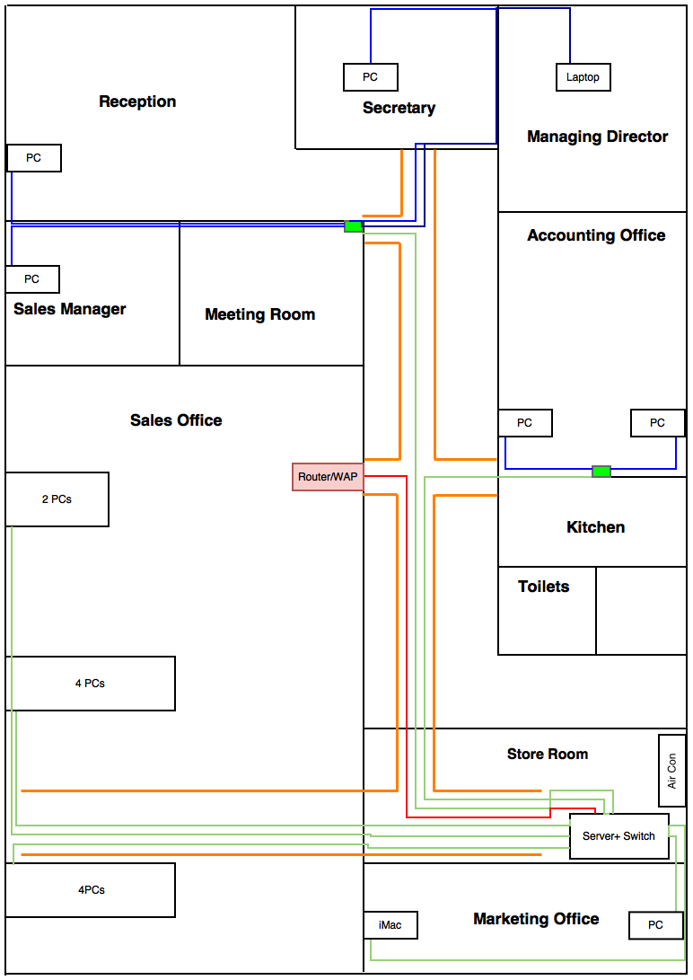
Network Topology
A complex star
Most efficient and cost effective
Fast and secure
Contains three switches
A router provided by the ISP

Slide 7
Network Hardware
Switches
NETGEAR 24-Port Smart Gigabit
NETGEAR 8-Port Smart Gigabit
Medium
Category 6 shielded Ethernet cable
1 Gb/s transfer speeds
Trunking and cable trays

Slide 8
Internet Service provider
Virgin Media
Managed Internet Access
300 Mbit/s symmetric speeds
Internet monitoring and managing service, using business class SLAs
Faults are fixed within 9 hours
Leased Line, VPN, Security, Resilience and Managed Authentication
Cisco router

Slide 9
Redundancy
Virgin provides a back up line
Increased symmetric speeds
Extra switches and Ethernet cable
Devices can use Wi-Fi connection
Multiple switches implemented

Slide 10
Conclusion
The benefits of this network solution:
Staff can upload records to the server
Much faster and efficient
Improved communication and information access
More secure

Slide 11
PC Hardware
Client PCs and Server

Slide 12
Requirements
A new set of PCs
Capable of office tasks
A Server implemented
Capable of keeping track of databases
Capable of hosting an Extranet/website

Slide 13
Computer for Marketing Manager
iMac
Final Cut Pro software
Ideal for marketing manager
Benefits
More updated and powerful
iMac currently in use

Slide 14
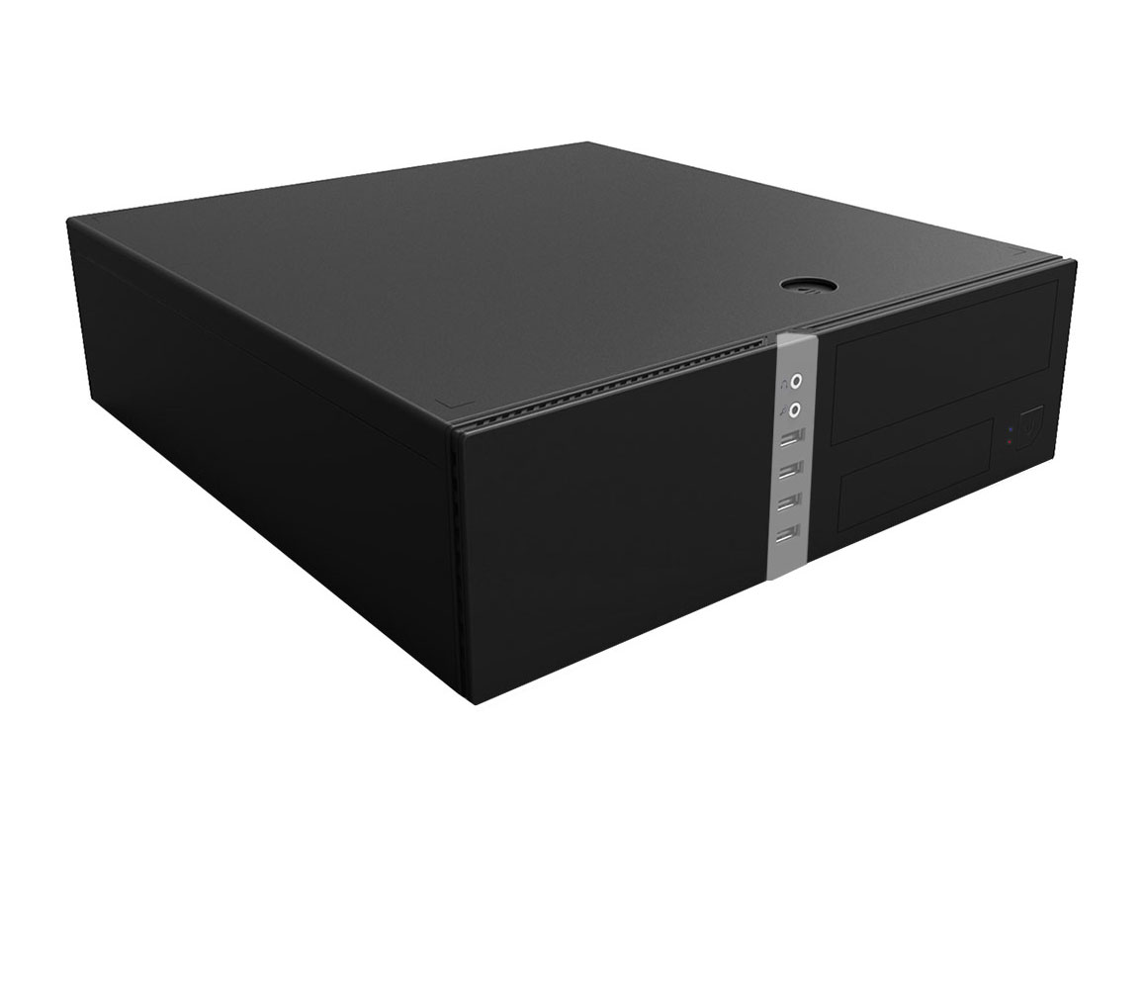
Hardware – Client PCs
Custom-Built
Capable
Future Upgrades
CiT – Mid Tower PC Case

Slide 15
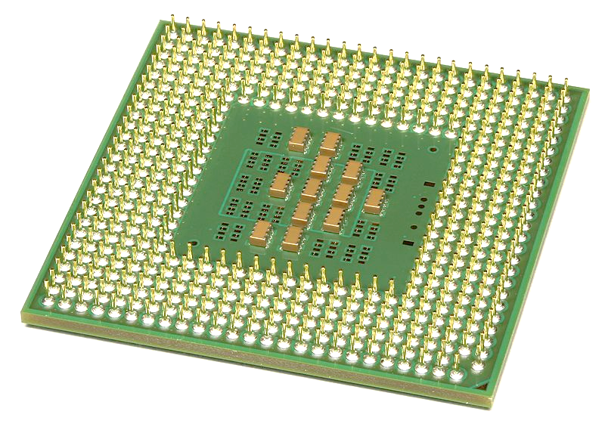
Hardware – Client PCs – CPU
Intel Pentium G3250
Dual Core
Socket 1150
Relevant Socket
(Kuru, 2010)

Slide 16
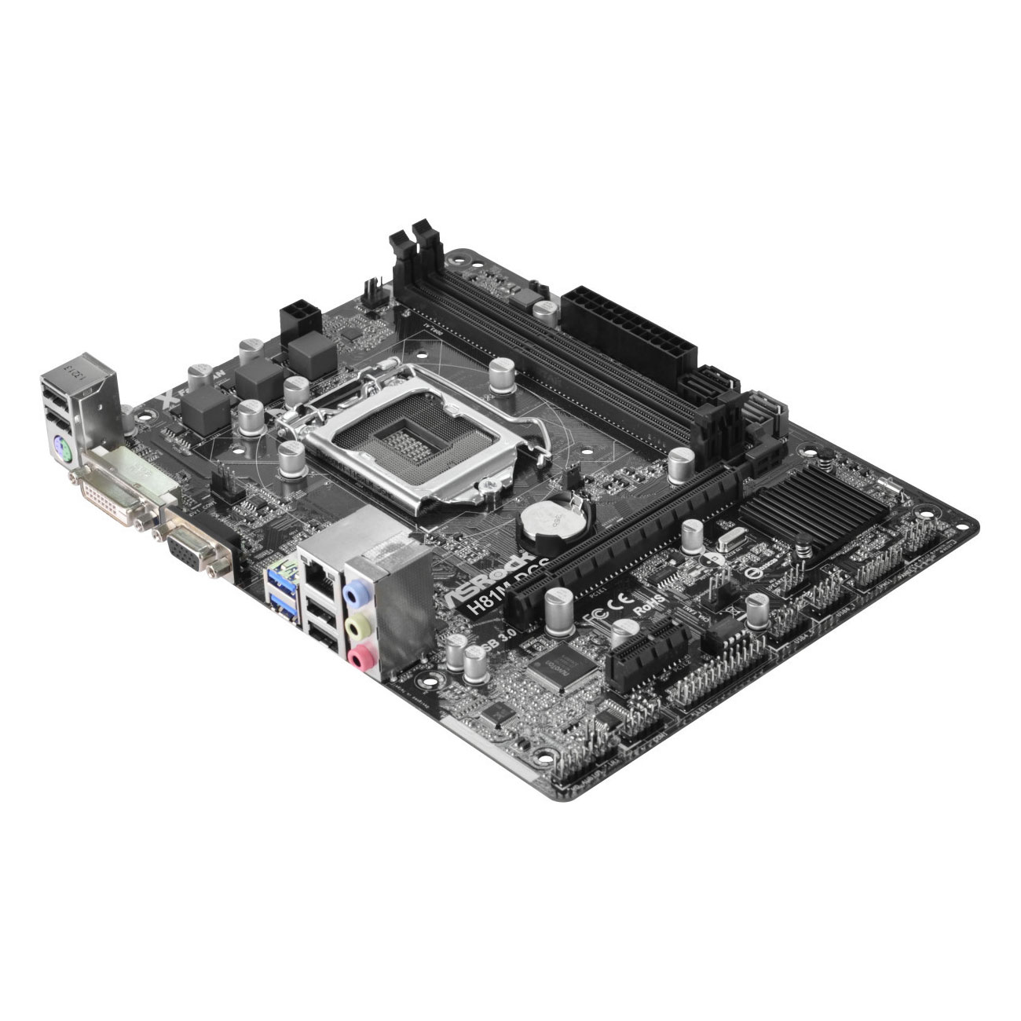
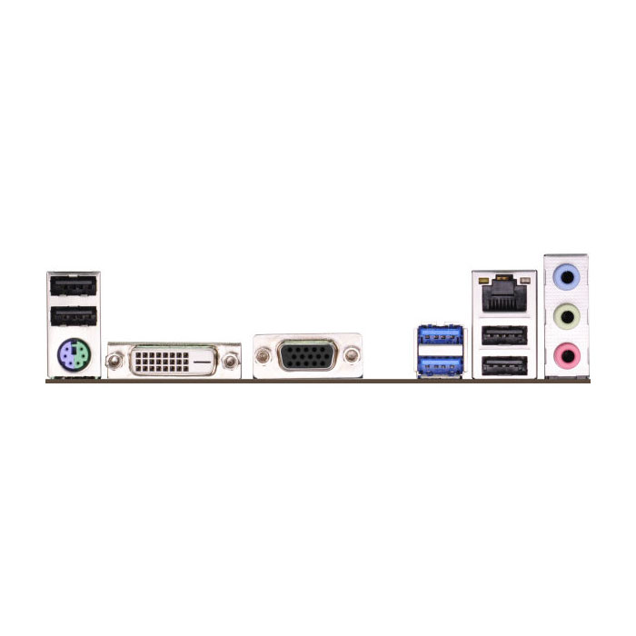
Hardware – Client PCs - Motherboard
AS Rock H81M-DGS
µATX Form Factor
Up to 16GB RAM
Gigabit Ethernet
(ASRock H81M-DGS R2.0 Micro-ATX Motherboard, 2015)

Slide 17
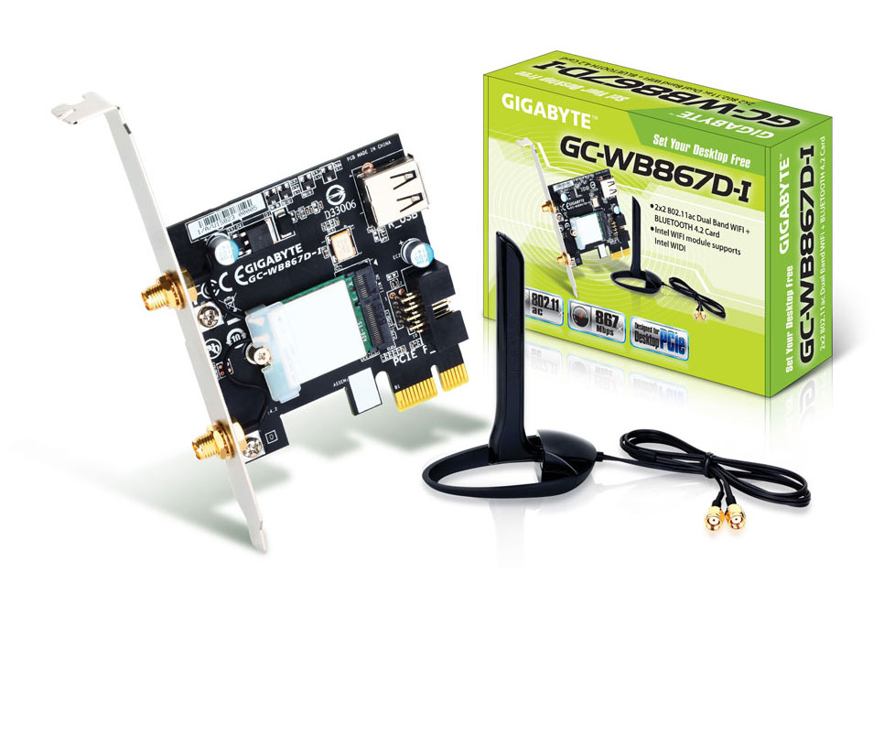
Network Connectivity
Gigabit Ethernet
WiFi
802.11ac
Up to 867Mbps
Dual Band
(Gigabyte, 2016)

Slide 18
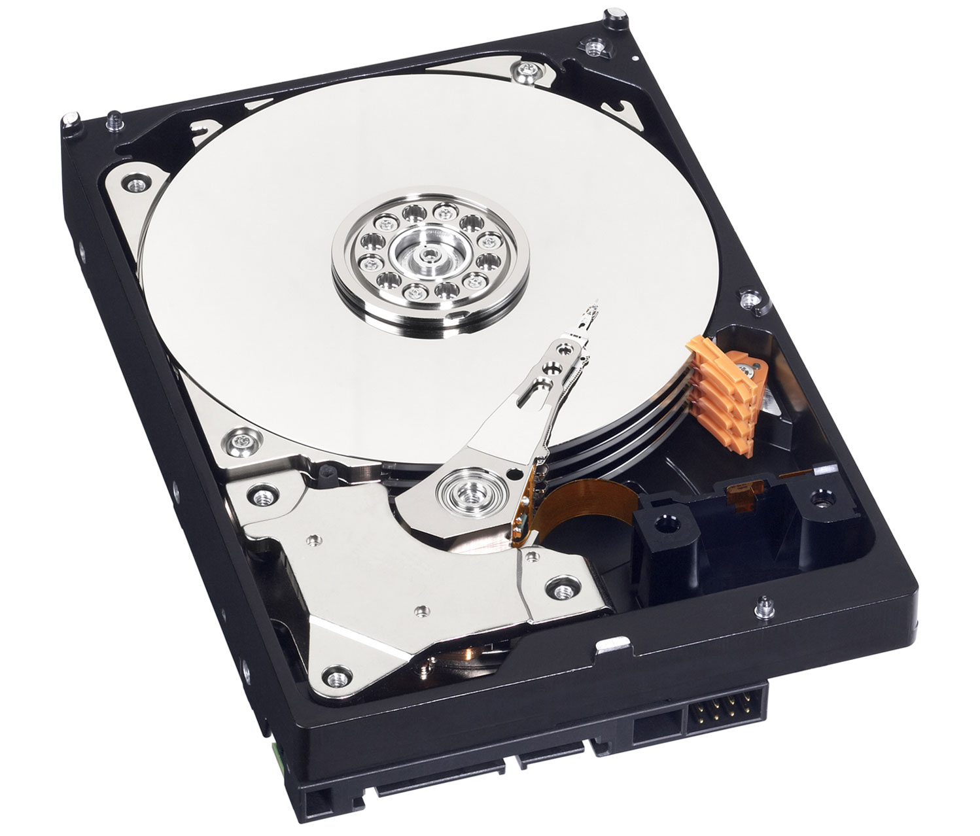
Hardware – Client PCs – Other Components
Memory
Corsair
2 x 4GB @ 1333MHz
HDD
WD Blue
SATA III
1TB
PSU
CiT
400W
(Western Digital Blue WD10EZEX, 2016)

Slide 19
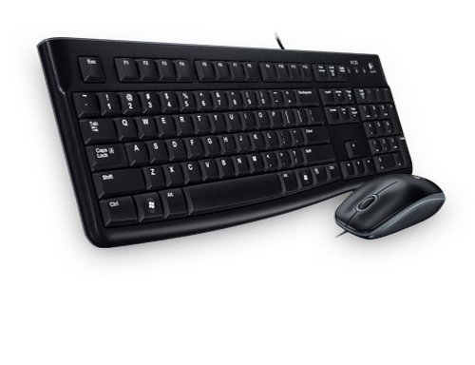
Hardware – Client PCs - Peripherals
Keyboard & Mouse
Logitech MK120
1000DPI
Optical
Monitor
Ilyama
1920 x 1080
HDMI
(Logitech MK120, 2015)

Slide 20
Benefits of Solution
Uses Upgradeable Hardware
Will run well in an Office.
Small Form Factor.

Slide 21
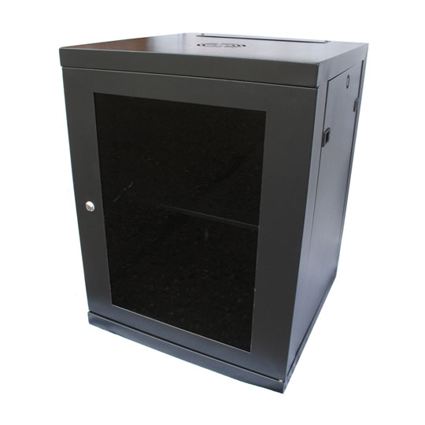
Hardware – Server - Cabinet
LMS Data
18U
Wall Mounted
Lockable
Air Cooled
(LMS Data Server Cabinet, 1987)

Slide 22
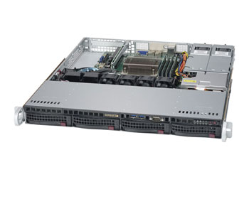
Hardware – Server Blade
SuperMicro
Socket 1151
Upto 64GB RAM
4 x Hot Swap HDD Bays
2 x Gigabit Ethernet Ports
(SuperMicro 5019S-MR-3Y Server, no date)

Slide 23
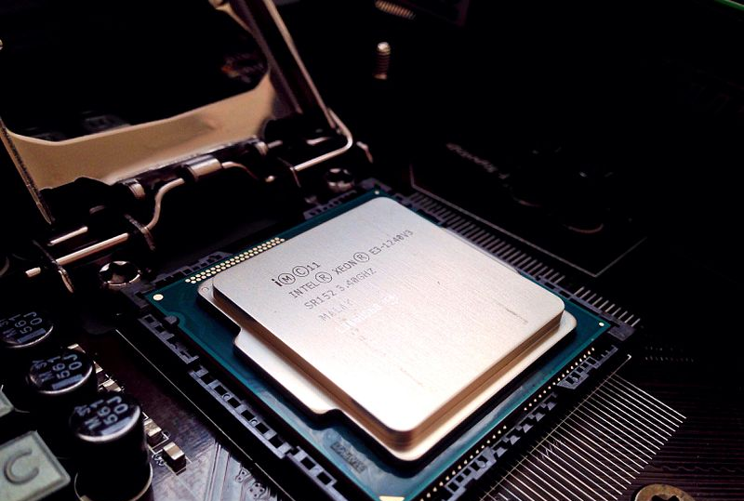
Hardware – Server - CPU
Intel Xeon E3 – 1220
3GHz (3.5GHz Boost)
Quad Core
(Intel Xeon E3 Series CPU, 2013)

Slide 24
Hardware – Server – Other Components
Memory
Crucial
DDR4
2 x 8GB @ 2133MHz
HDD
WD
SATAIII
4 x 1TB
PSU
2 x 400W Platinum
Battery Backup
(SuperMicro 5019S-MR-3Y Server, no date)

Slide 25
Benefits of Solution
Again, Upgradeable Hardware
CPU
Memory
Storage solution offers more space for future expansion
Power Supply Redundancy
Battery Backup

Slide 26
Software
Operating Systems, Sage Accounting, Sage CRM

Slide 27
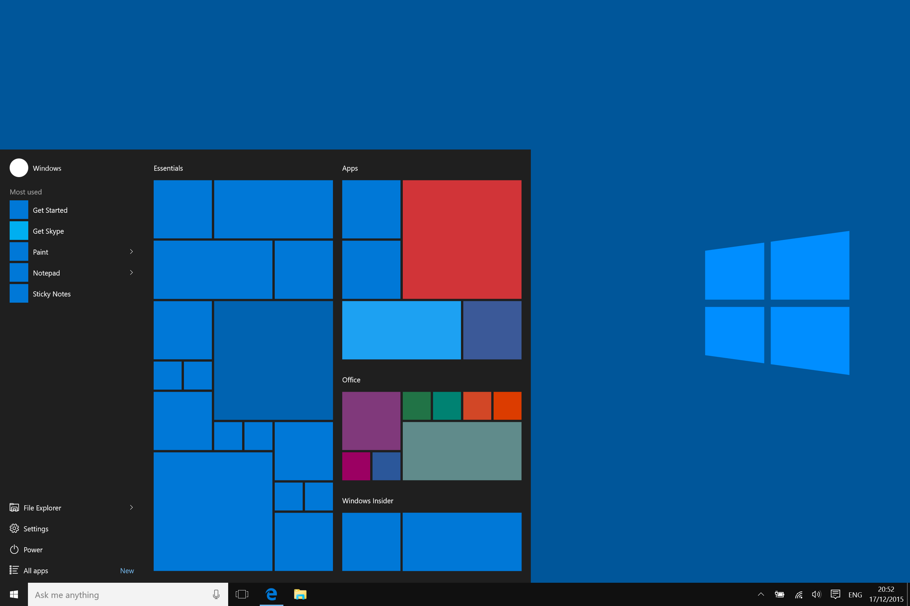
Client PC – Windows 10
Familiar OS
Latest version of Microsoft Windows
Additional Business Functionality
Trusted boot
(Microsoft, 2015)

Slide 28
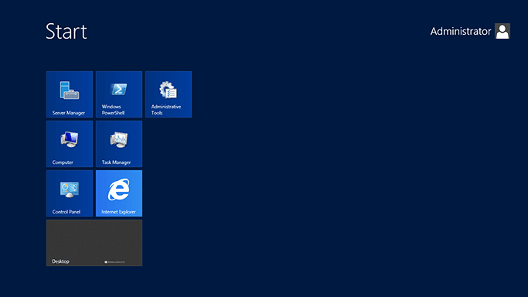
Server – Windows Server 2012 R2
Latest Version of Microsoft Windows Server
Easy to get programs running
Remote Desktop
Allows manipulation without direct server access
Extra Features for Business
(Microsoft, 2016c)

Slide 29
WHY SAGE?
Was used previously by employees
Suitable for small businesses
Less time for employees to be trained on it.

Slide 30
Benefits of sage
Sage offers more packages than any other Accounting software
Improves communication and collaboration between all areas of the business
Enhance productivity, customer satisfaction, flexibility and control Handle operations across multi-national markets.

Slide 31
Specification of sage
Automatic bank feeds
Performance summaries
Create custom quotes and invoices
Tracking monthly income and expenses
Produce advanced reports
Account collaboration
Multiple users and companies

Slide 32
Customer Relationship Management system (CRM)
Requirements
Data Consolidation
Difficulties in retrieving customer information, due to customer sales records being kept on paper and sales reps storing client contact details locally in diaries and on card index.
Improved Efficiency
Too few calls made each day, due to the manual system being too slow.
Salesforce Automation
Call backs or sales opportunities missed, because of the lack of automatic reminders
Targeted Marketing Campaigns
Promotions not targeted well, due to mailing lists being held externally.
Improved Communication Between Departments

Slide 33

CRM Solution
Sage CRM
Preferred choice SageACT!
Out of the Box Integration with Sage Accounting Software

Slide 34
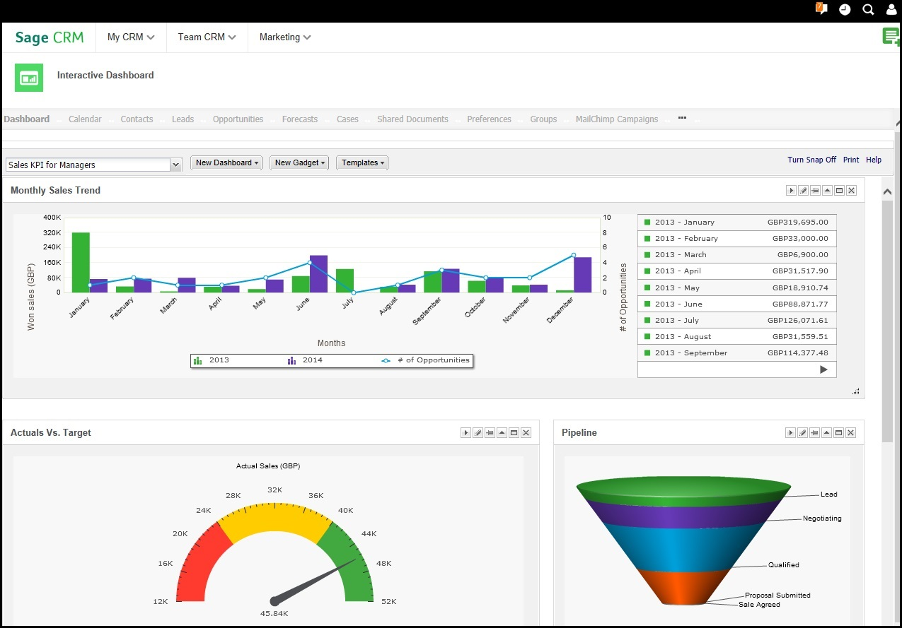
Benefits of Solution
Centralised Data
Simplified data retrieval
Access data anywhere and anytime
Efficient business processes
Workflow automation
Integration with accounting software
Targeted marketing Campaigns
Trend spotting
Email Campaigns
Social media monitoring

Slide 35
Intranet
An intranet system is needed for teaching purposes
The intranet will also allow staff to stay in contact with each other
Staff and student profiles will allow for good relationship between users

Slide 36

Intranet Solution
Moodle
Free – No licensing fees
Easy to use
Lots of users may all ready have had experience using the software
All in one learning platform

Slide 37
Security
Physical and Technical

Slide 38
Introduction
The Data Protection Act 1998 states, under Principle 7-Security,
“Appropriate technical and organisational measures shall be taken against unauthorised or unlawful processing of personal data and accidental loss or destruction of, or damage to, personal data”. (Gov, 1998)
Physical Security
Physical security protects the machine and peripheral hardware, such as hubs and switches, from theft, electronic intrusion and damage.
Technical Security
Technical security provides barriers and other tools that protect programs, files and the flow of information to and from a computer.

Slide 39
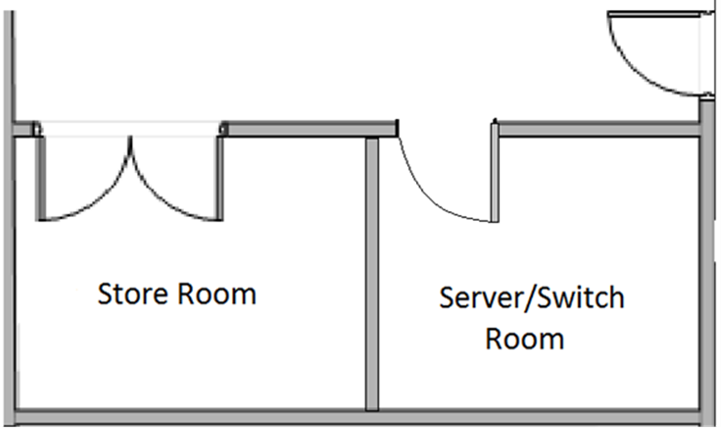
Physical Security Solution
Create a secure server room
Split the store room in two with a stud partition wall
Replace the suspended ceiling
Install a high security steel door
Fitted with a code lock medium security electronic lock

Slide 40
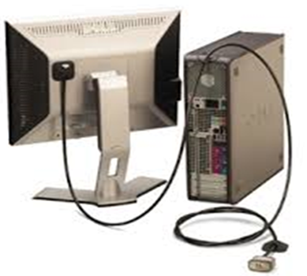
Physical security solution
PC Locks

Slide 41
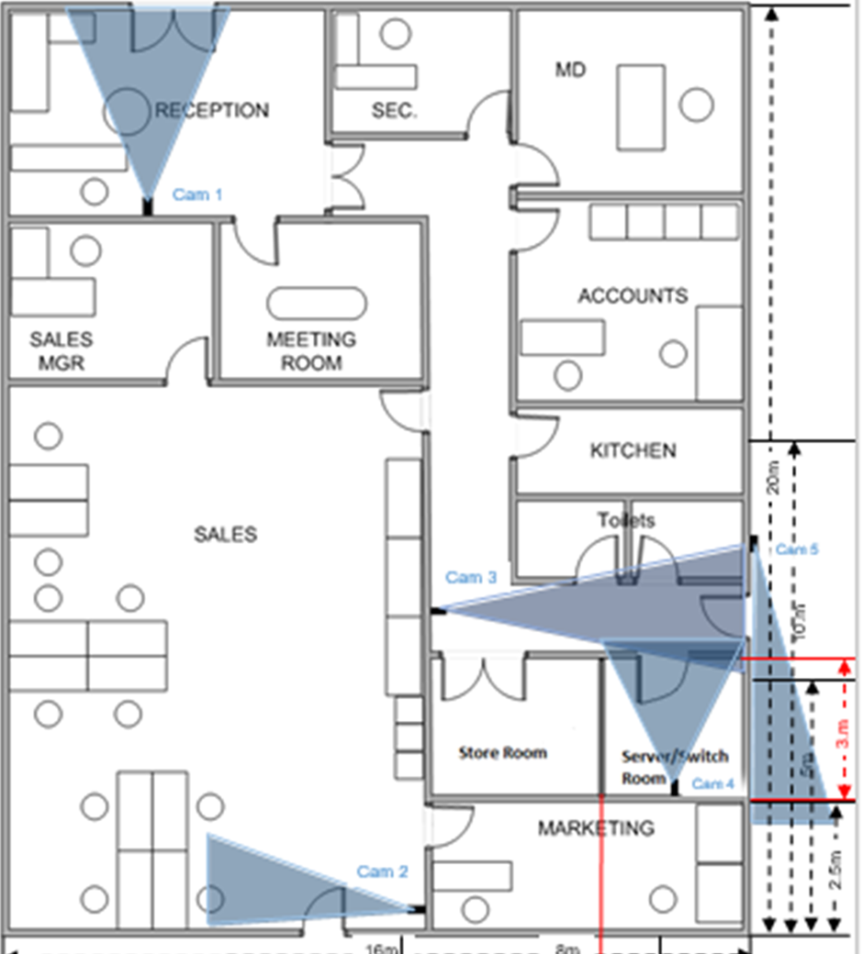
Physical security solution
CCTV System
Internal
CAM 1: Covering front entrance
CAM 2: Covering sales entrance
CAM 3: Covering server/switch room corridor and
rear entrance
CAM 4: Inside the server/switch room
External
CAM 5: Covering the rear entrance
Monitor and DVR in secretary's office

Slide 42
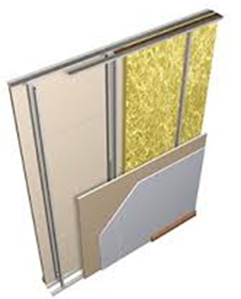
Benefits of Solution
Server/Switch Room
Fully Insulated
Electronic Lock
CCTV
1TB Hard Drive
Dedicated Monitor

Slide 43
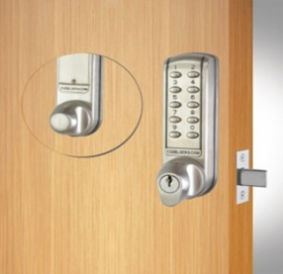
Benefits of Solution
Server/Switch Room
Fully Insulated
Electronic Lock
CCTV
1TB Hard Drive
Dedicated Monitor

Slide 44
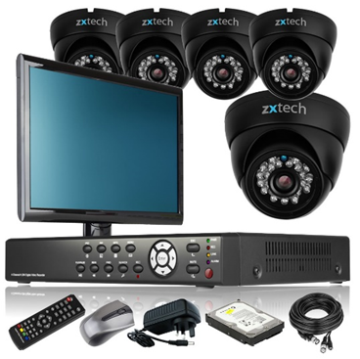
Benefits of Solution
Server/Switch Room
Fully Insulated
Electronic Lock
CCTV
1TB Hard Drive
Dedicated Monitor

Slide 45
Technical SECURITY – WHY?
Key to ensuring safeguarding
Legal - Data protection
Access Control
Policies and Procedures

Slide 46
Technical SECURITY
Email Security
Access Control
Firewalls and Anti-Virus

Slide 47

recommendations
Symantec Endpoint Protection Small to Medium Business Edition
20 endpoints
3 year subscription £760
Easy setup
Ideal for a business with no dedicated IT maintenance employee

Slide 48
Training

Slide 49
Training
Who needs training?
Administration training (Sales AM)
Server maintainer
Moodle
CRM-Sage will look after this
Sage AS
Network Management
Maintaining network hardware
Troubleshooting issues

Slide 50
Installation and costs

Slide 51
Installation Schedule
Its going to take about a week to be completed, with a maximum of 2 days down time

Slide 52
costs
Network hardware £1912.50
PC Hardware £6358.00
Server Hardware £5088.05
Other Hardware £1737.97
ISP 1 year £8400
£23496.52
Software
Sage CRM including training £7744
Sage 5o account standard £25 a month
Training for sage 50 £220 for four exams
£8784
Security
Physical £2493.00
Technical Security £760 (3 year subscription)
£3253
Total Cost: £35533.52

Slide 53
Citations
ASRock H81M-DGS R2.0 Micro-ATX Motherboard (2015) Available at: https://www.scan.co.uk/products/asrock-h81m-dgs-r20-intel-h81-s-1150-ddr3-sata-iii-6gb-s-pcie-20-(x16)-d-sub-(vga)-dvi-d-micro-atx-m (Accessed: 3 December 2016).
Kuru, D. (2010) Intel Pentium M Available at: https://commons.wikimedia.org/wiki/File:Intel_Pentium_M_1.4_(RH80535GC0171M)-bottom_oblique_PNr%C2%B00336.jpg (Accessed: 3 December 2016).
CiT, Cit S503 Tower Case. 2016. Web. 25 Nov. 2016.
Western Digital Blue WD10EZEX (2016) Available at: https://www.scan.co.uk/products/1tb-wd-blue-wd10ezex-sata-iii-6gb-s-7200rpm-64mb-cache-8ms-oem-hdd (Accessed: 3 December 2016).
Logitech MK120 (2015) Available at: https://www.scan.co.uk/products/ogitech-desktop-mk120-wired-keyboard-usb-1000dpi-optical-mouse-black (Accessed: 3 December 2016).
LMS Data Server Cabinet (1987) Available at: https://www.scan.co.uk/products/18u-19-550mm-deep-wall-mount-cabinet-black (Accessed: 3 December 2016).
SuperMicro 5019S-MR-3Y Server (no date) Available at: https://www.scan.co.uk/3xs/configurator/rack-server-intel-xeon-e3-1200-supermicro-5019s-mr2 (Accessed: 3 December 2016).
Intel Xeon E3 Series CPU (2013) Available at: https://commons.wikimedia.org/wiki/File:Intel_Xeon_E3-1240V3_Haswell_3.40GHz.jpg (Accessed: 3 December 2016).
SuperMicro Server Blade (2016) Available at: https://en.wikipedia.org/wiki/Blade_server#/media/File:Supermicro_SBI-7228R-T2X_blade_server.jpg (Accessed: 3 December 2016).
Microsoft (2016c) Wikipedia Available at: https://en.wikipedia.org/wiki/File:Start_screen_on_Windows_Server_2012.png, used with permission from Microsoft (Accessed: 12 December 2016).
Microsoft (2015) Wikipedia Available at: https://simple.wikipedia.org/wiki/File:Windows10abstract.png (Accessed: 12 December 2016).
Gigabyte (2016) Gigabyte 11ac Wireless PCIe Card Available at: https://www.scan.co.uk/products/gigabyte-gc-wb867d-i-(rev-42)-pcie-wifi-card-867mbps-dual-band-80211ac-bluetooth-42-pci-e-20-externa (Accessed: 13 December 2016).

Slide 54
Citations
ASRock H81M-DGS R2.0 Micro-ATX Motherboard (2015) Available at: https://www.scan.co.uk/products/asrock-h81m-dgs-r20-intel-h81-s-1150-ddr3-sata-iii-6gb-s-pcie-20-(x16)-d-sub-(vga)-dvi-d-micro-atx-m (Accessed: 3 December 2016).
Kuru, D. (2010) Intel Pentium M Available at: https://commons.wikimedia.org/wiki/File:Intel_Pentium_M_1.4_(RH80535GC0171M)-bottom_oblique_PNr%C2%B00336.jpg (Accessed: 3 December 2016).
CiT, Cit S503 Tower Case. 2016. Web. 25 Nov. 2016.
Western Digital Blue WD10EZEX (2016) Available at: https://www.scan.co.uk/products/1tb-wd-blue-wd10ezex-sata-iii-6gb-s-7200rpm-64mb-cache-8ms-oem-hdd (Accessed: 3 December 2016).
Logitech MK120 (2015) Available at: https://www.scan.co.uk/products/ogitech-desktop-mk120-wired-keyboard-usb-1000dpi-optical-mouse-black (Accessed: 3 December 2016).
LMS Data Server Cabinet (1987) Available at: https://www.scan.co.uk/products/18u-19-550mm-deep-wall-mount-cabinet-black (Accessed: 3 December 2016).
SuperMicro 5019S-MR-3Y Server (no date) Available at: https://www.scan.co.uk/3xs/configurator/rack-server-intel-xeon-e3-1200-supermicro-5019s-mr2 (Accessed: 3 December 2016).
Intel Xeon E3 Series CPU (2013) Available at: https://commons.wikimedia.org/wiki/File:Intel_Xeon_E3-1240V3_Haswell_3.40GHz.jpg (Accessed: 3 December 2016).
SuperMicro Server Blade (2016) Available at: https://en.wikipedia.org/wiki/Blade_server#/media/File:Supermicro_SBI-7228R-T2X_blade_server.jpg (Accessed: 3 December 2016).

